Slide 1
Q&A
IOH
Apr’24
OGPM – DGCEO’s OFFICE

Slide 2
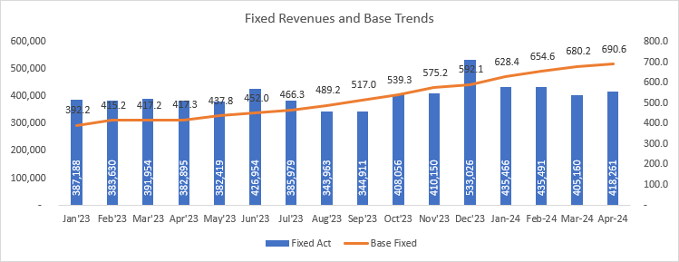
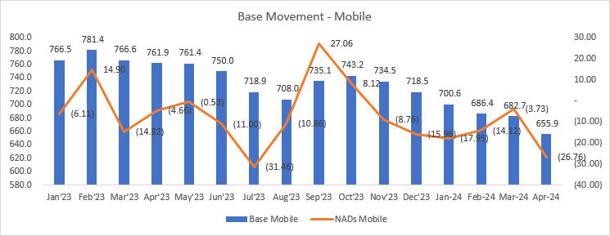
IOH – Apr’24 - Q&A and deep dives
COMMERCIAL
CONSUMER
No question.
BUSINESS SERVICES
B2B
Overall B2B MTD / YTD revenue exceeded budget by 11% and 14% respectively (YoY @ 28%)
Driven by A2P revenue booking Mobile MTD revenue exceeding the budget by 99% (YoY @ 200%) whereas Fixed MTD revenue exceeded budget by 3% (YoY 14%)
On YTD basis, Mobile revenue exceeded budget by 103% (YoY 159%) whereas Fixed exceeded budget by 6% (YoY 17%)
B2B MTD Cost of sales increased by 5% on MoM basis (YoY +53%), however remained below budget by -3% on YTD basis.
Lintasarta is performing above YTD Apr’24 revenue target by 0.6% and EBITDA margin exceeding AOP by 6.4%
YoY positive trends on margins -both at Gross and EBITDA levels
Mobile Input Business KPIs are trending negative
Customers / Base : Declined from 743K in Oct 23 to 656 K in Apr’24. MoM decline as well , by 27K
Accounts : count dropping from 15,719 to 15,406 between Jan’24 and Mar’24 (IOH reports M-1)
B2B
Q1: Mobile:
Q: With input KPIs declining, what is driving revenue growth?
Q: What is the split between organic mobile business and domestic A2P?
Q2: Fixed: The underlying fixed revenue are at an average of IDR 418 Mn, while base has grown by ~ 150K.The base grew by 28% , revenues improved by 3%.
Act.: IOH to share split between fixed Voice and fixed internet/data – subscribers (DELs) and revenues.
C1: LA: Whilst on YTD basis, Lintasarta performed above YTD budget by 0.6%, for Apr’24 it remained behind budget by -4.6%. Hope there is no risk on achieving the numbers.
WHOLESALE
Overall international wholesale in performing above YTD budget by 17% (YoY @ 7%)
Q3: international A2P revenue: (From past 2 months), the trending shows an increase of 15% whereas A2P cost increased by 1.5 times.
Act.: To share the split of off-net and on-net A2P revenue trends to clarify.

Slide 3
IOH – Apr’24 - Q&A and deep dives
FINANCE
YTD Gross Margin % is lower vs budget by 1pp. This is mainly due to change in accounting for Digital / Distribution model (agent to principal methodology).
GRAFM
No question.
TECHNOLOGY
Q1: IT complaints: Were reduced in the Excel report, to good and low levels in Feb’24 (396) and Mar’24 (352), but they increased back in Apr’24 531.
Q: Is there any known reason?
C1: Home-pass: April YTD Home-pass is at 1.45 Mn vs 1.68 Mn plan. IOH shows some progress but good to keep an eye: IOH has already approved 361K clean home passes after site survey, 1st 20k HPs planned to be ready in May’24 and overall 600k is expected in Oct’24.
C2: Reporting Incompleteness: IOH and OGT had a meeting and discussed the missing KPIs in the report. IOH will align internally and will come back to OGT.
STRATEGYrequesed.
No question
SOURCING
No question
LEGAL
No question.
REGULATORY
No question.
HR
HR Headcount is below the budget (4010 vs 4175)
The HR to headcount ratio is 1: 70
Staff cost is slightly above the budget for Apr’24 (3%). Shall monitor this.
Attrition is averaging below 0.5%
Training costs utilization within the budget.
OPEN ACTIONS / WATCH OUT POINTS:
None

